Slide 1
Rstan introduction*
Siyu Chen
Big Data Institute
Nuffield Department of Medicine
University of Oxford
siyu.chen@ndm.ox.ac.uk
*Some slides are adapted from Prof. Ben Cooper

Slide 2
Friday (1pm-4pm)
Bayes’ Theorem
Rstan introduction
Rstan practice
Flipping a coin
Fitting an ODE model to data using Stan

Slide 3
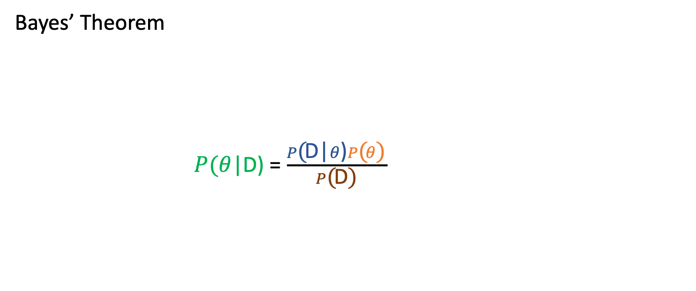
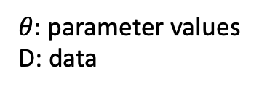
Bayes’ Theorem
$P(θ$|D) = $\frac{P\text{(}\text{D}\text{|}θ\text{)}P\text{(}θ\text{)} }{P\text{(}\text{D}\text{)}}$
$θ:$parameter values D: data
likelihood
prior
posterior
probability of the data (a normalizing constant)
Notes:
Mention here that typically not knowing the normalising constant makes evaluating this difficult.

Slide 4
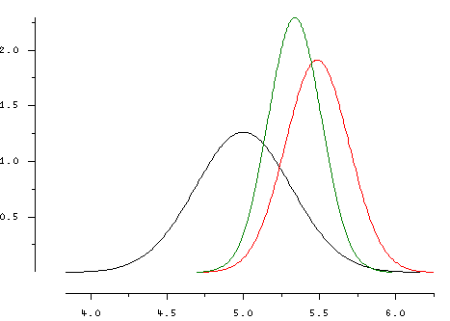
Posterior
Likelihood
Prior

Slide 5
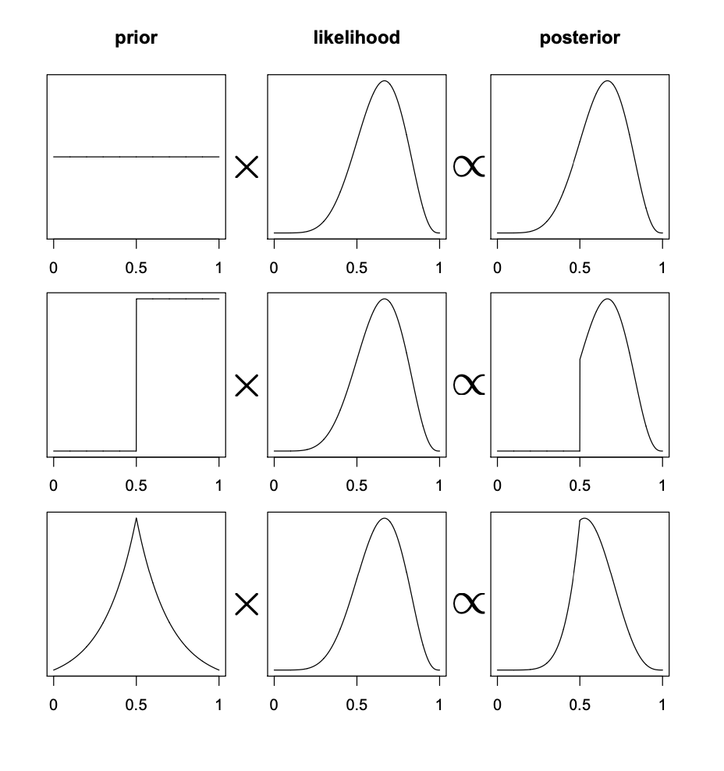
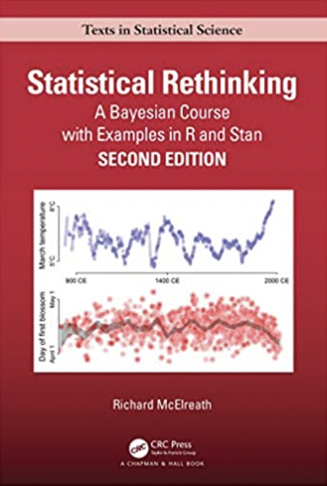

Slide 6
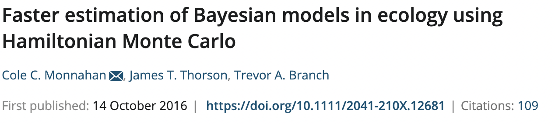
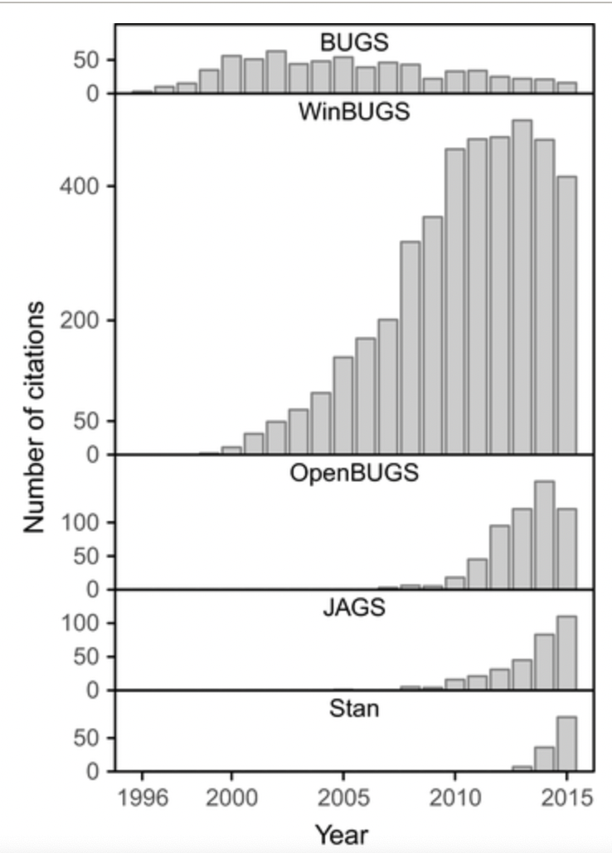
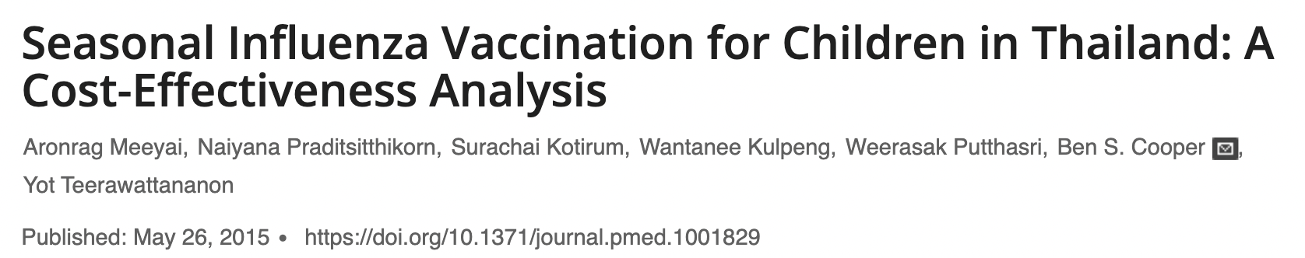
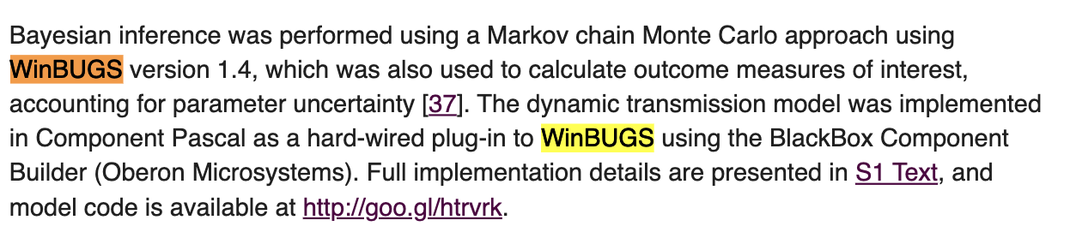
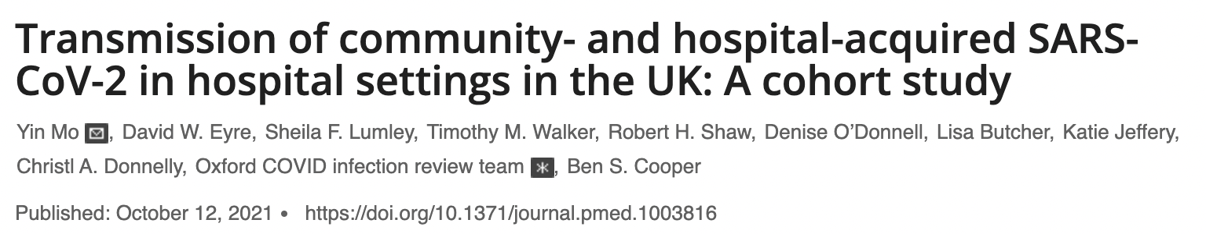
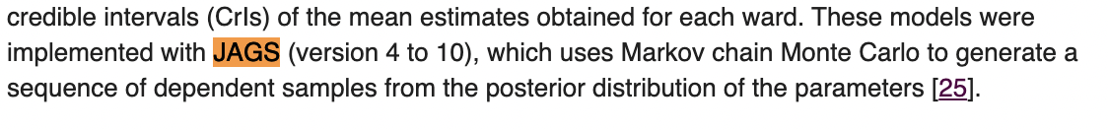
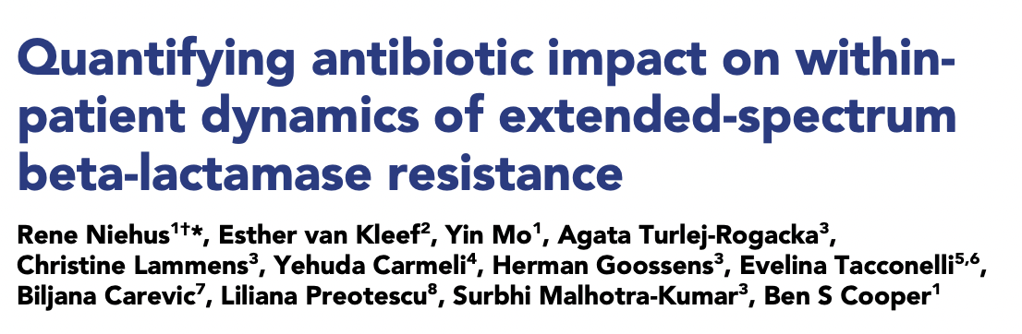
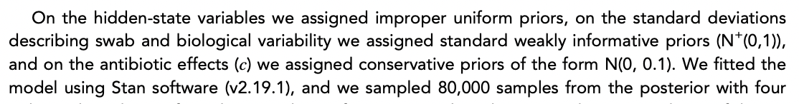

Slide 7
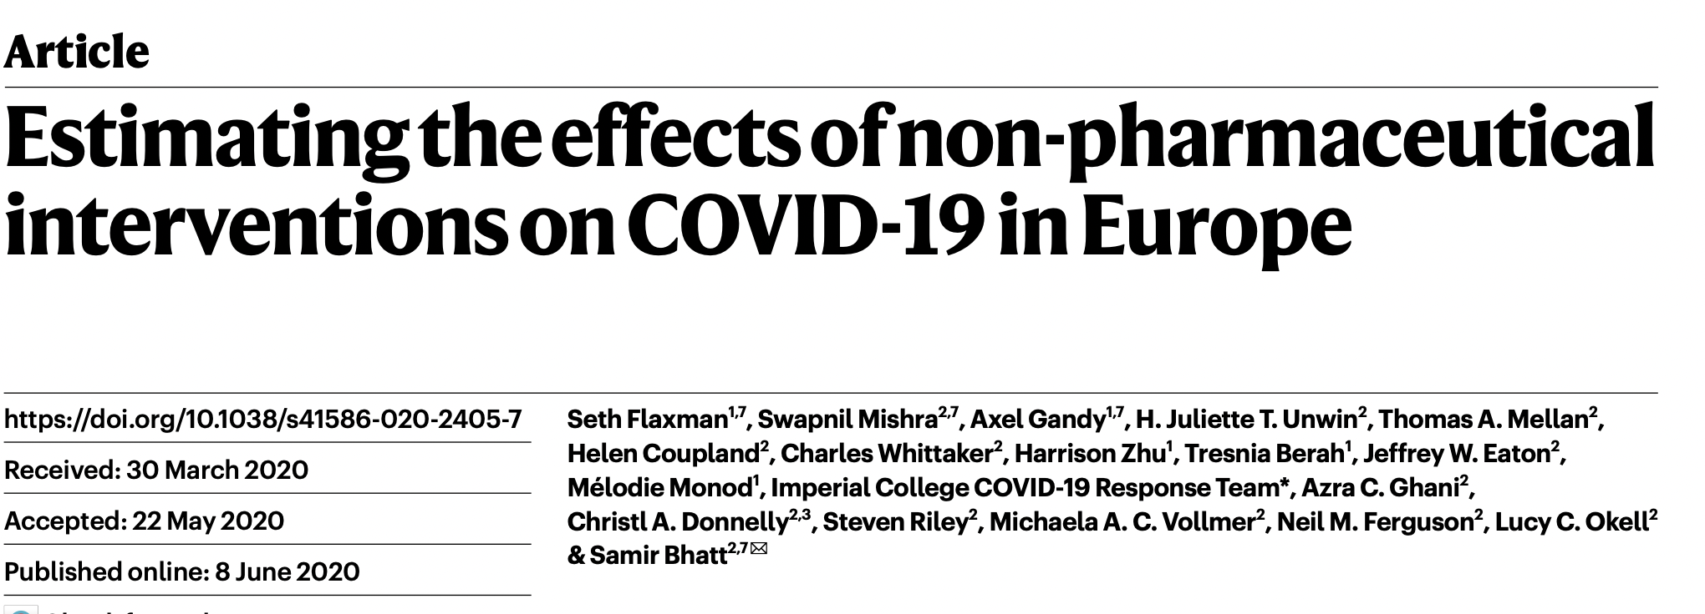
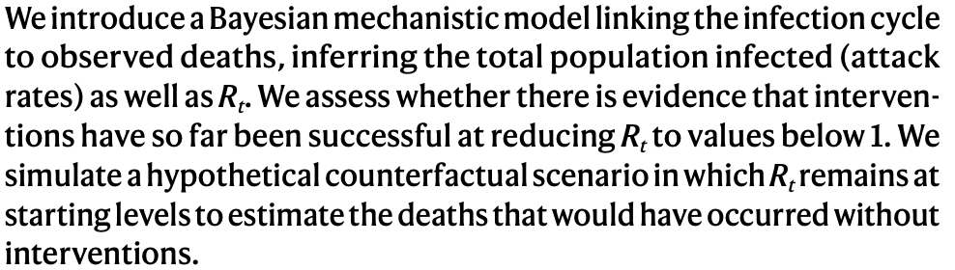
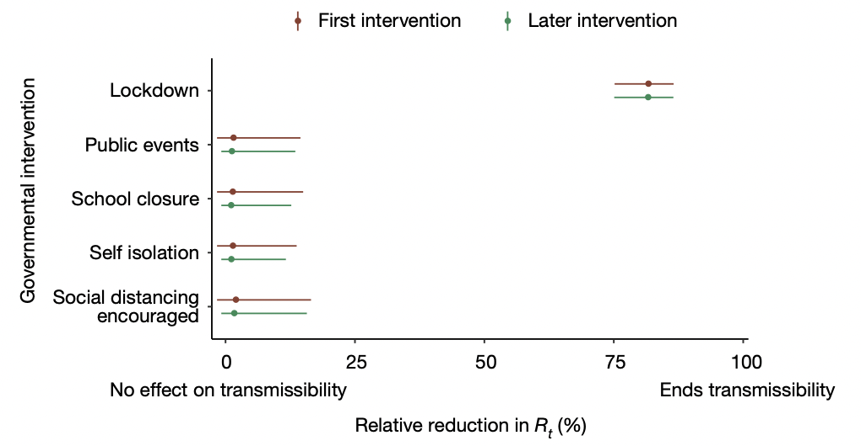
Recent papers using Stan

Slide 8
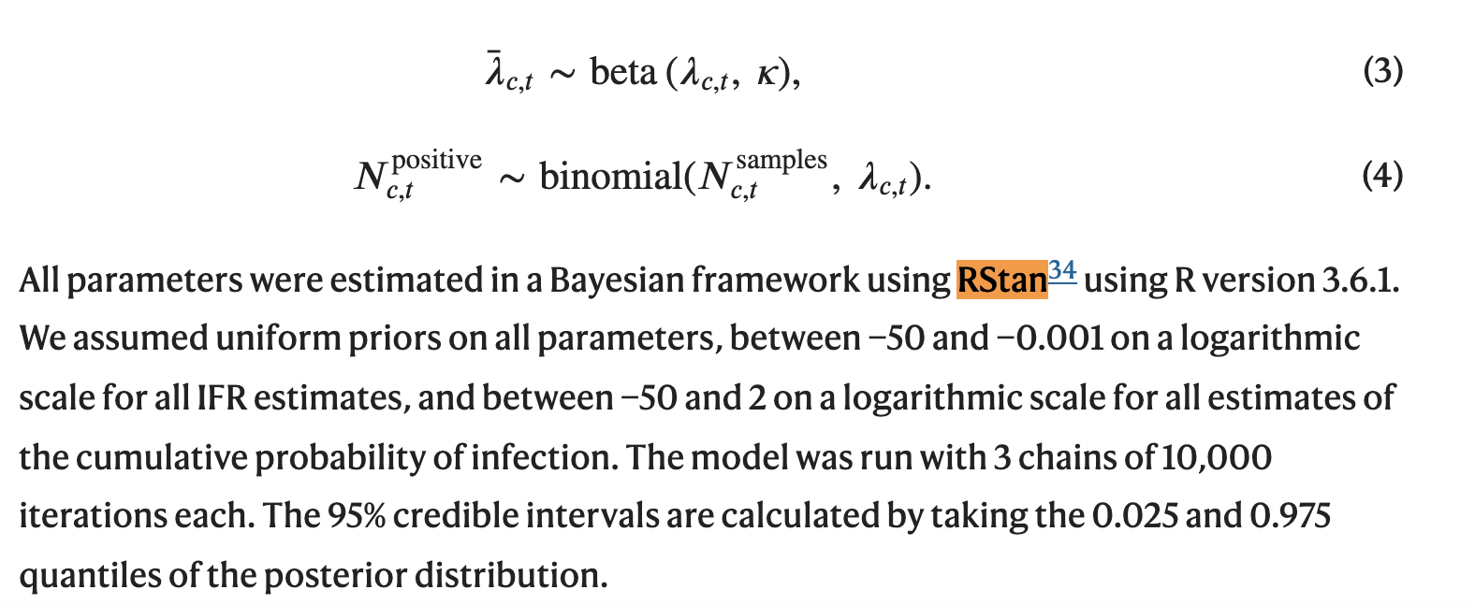
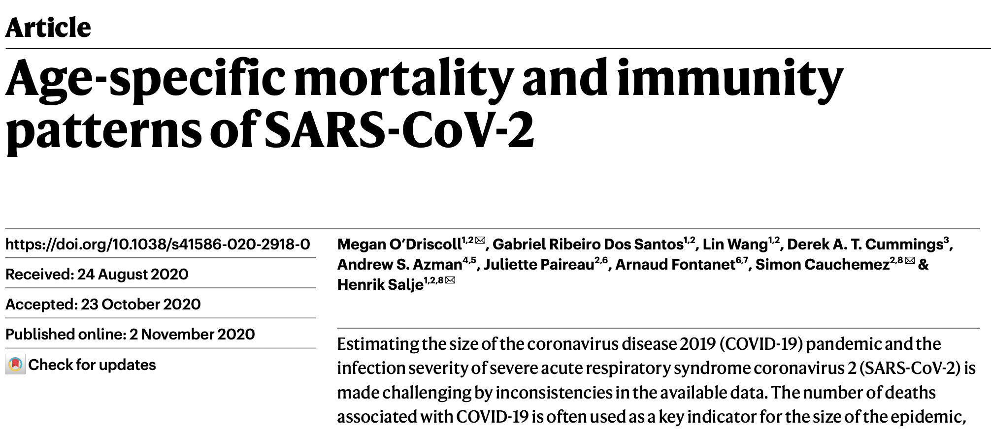
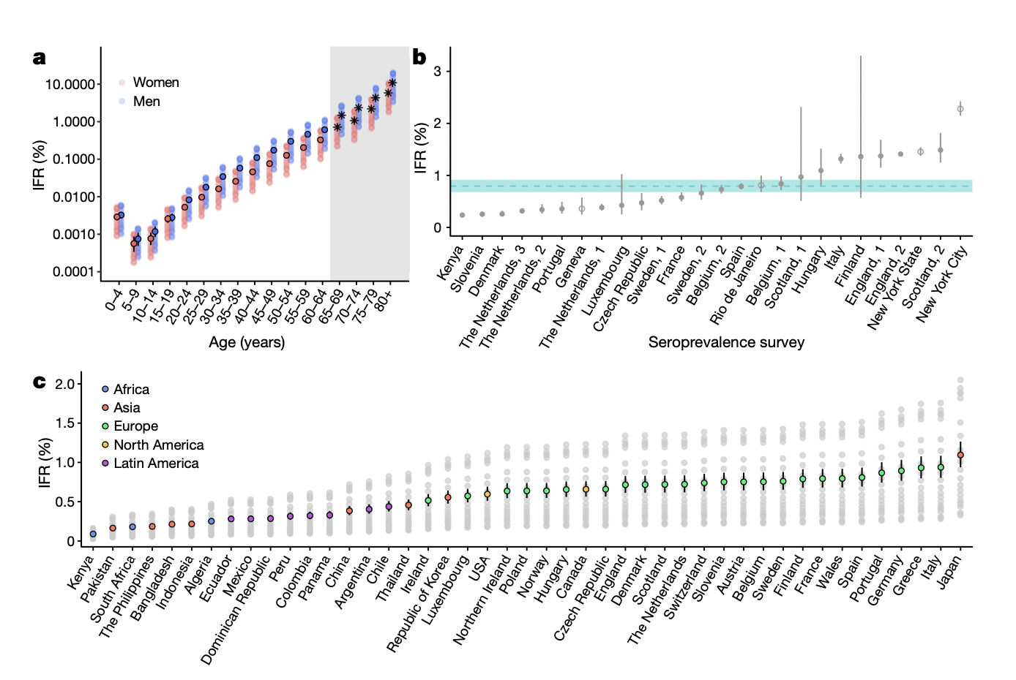
Recent papers using Stan

Slide 9
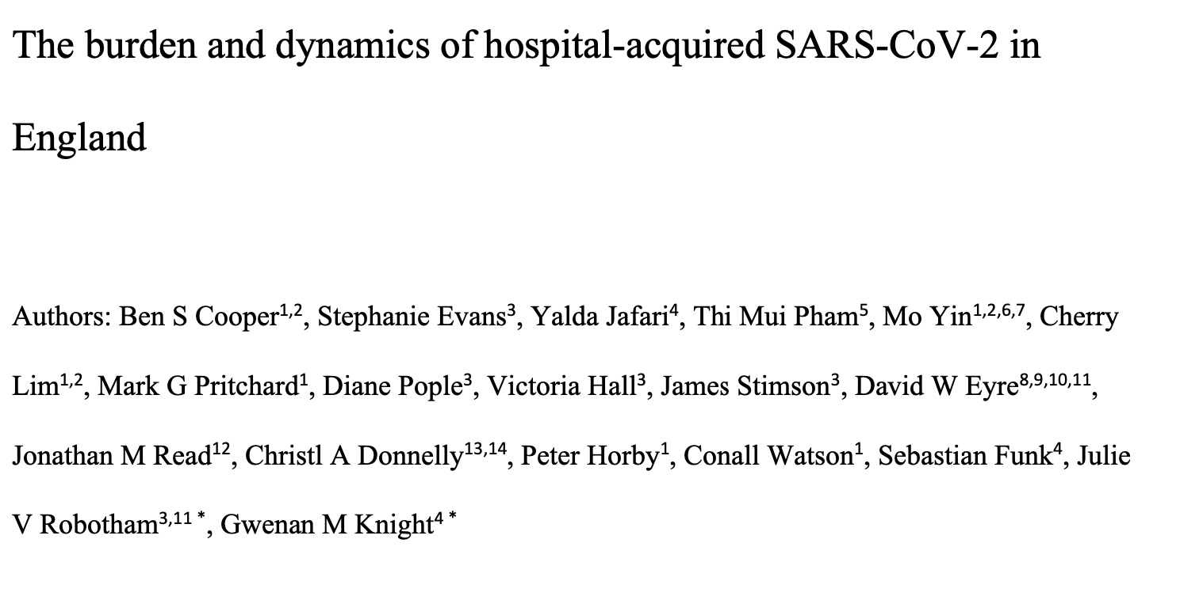
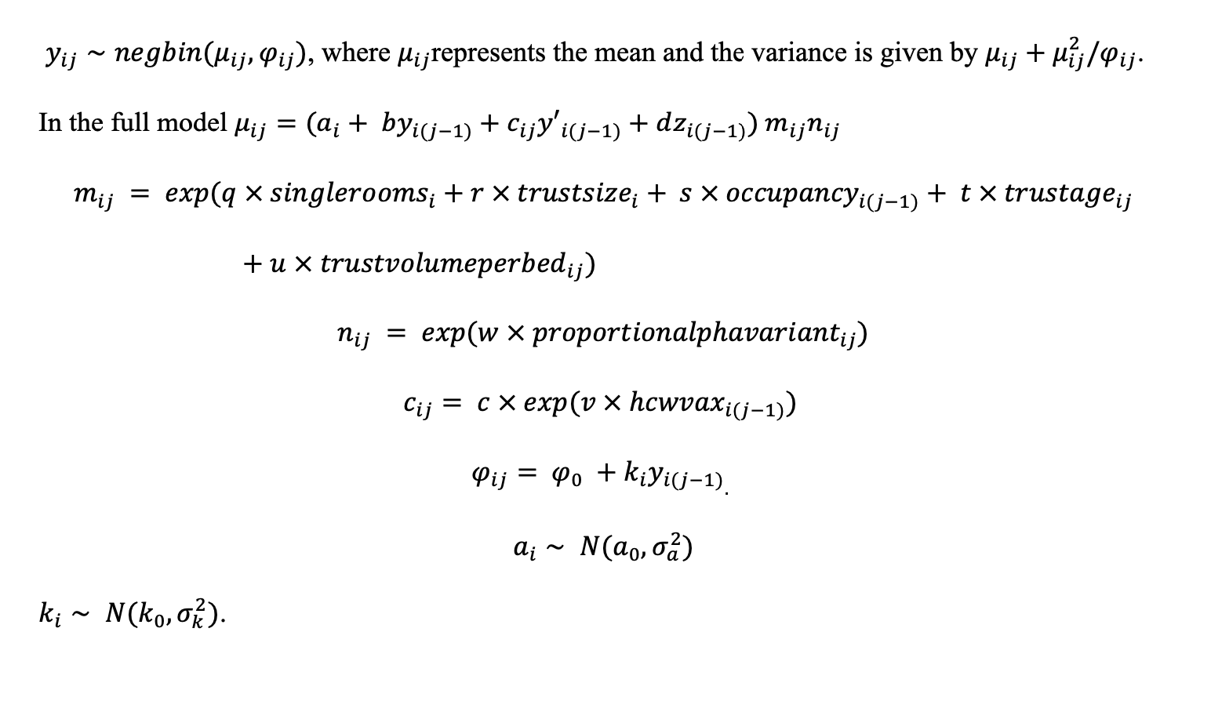
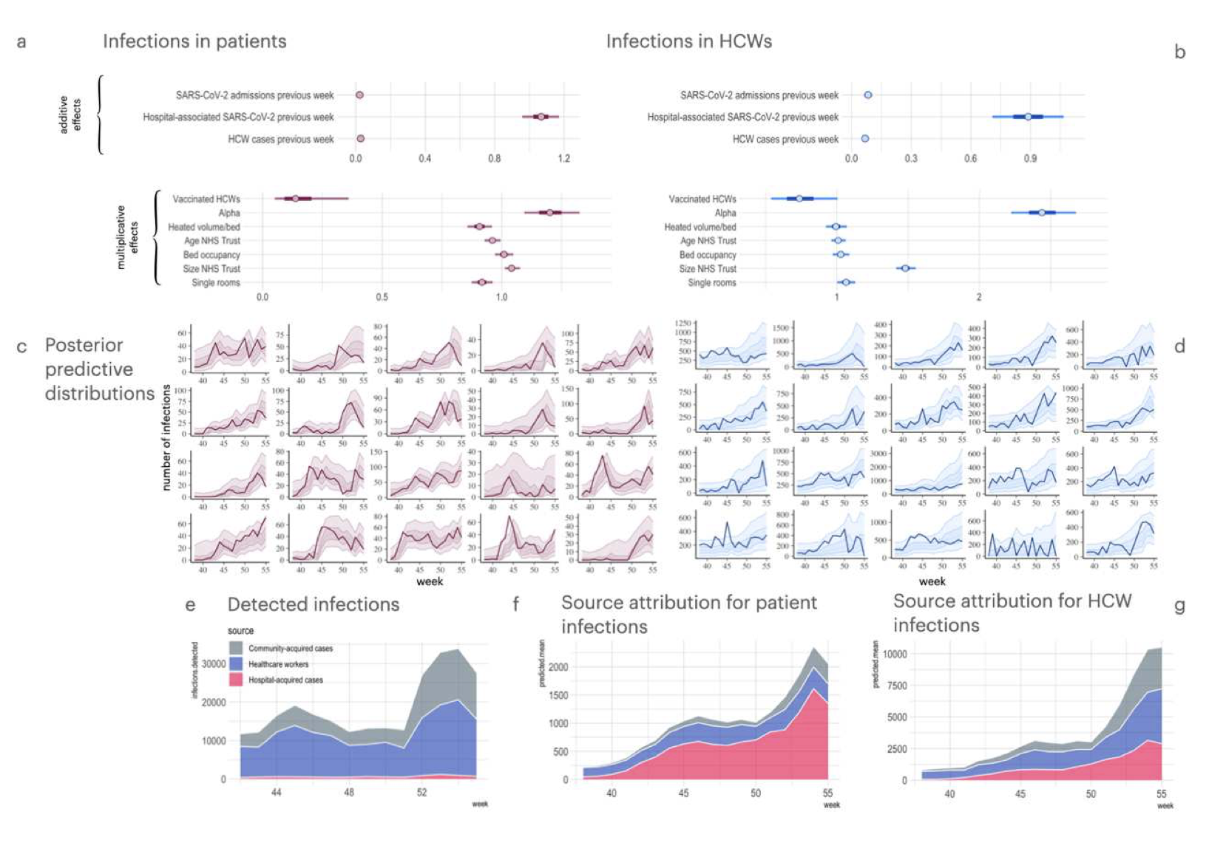
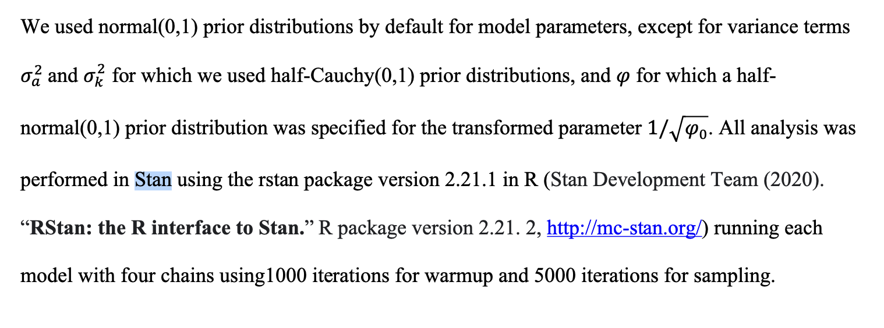
Recent papers using Stan
https://doi.org/10.21203/rs.3.rs-1098214/v1

Slide 10
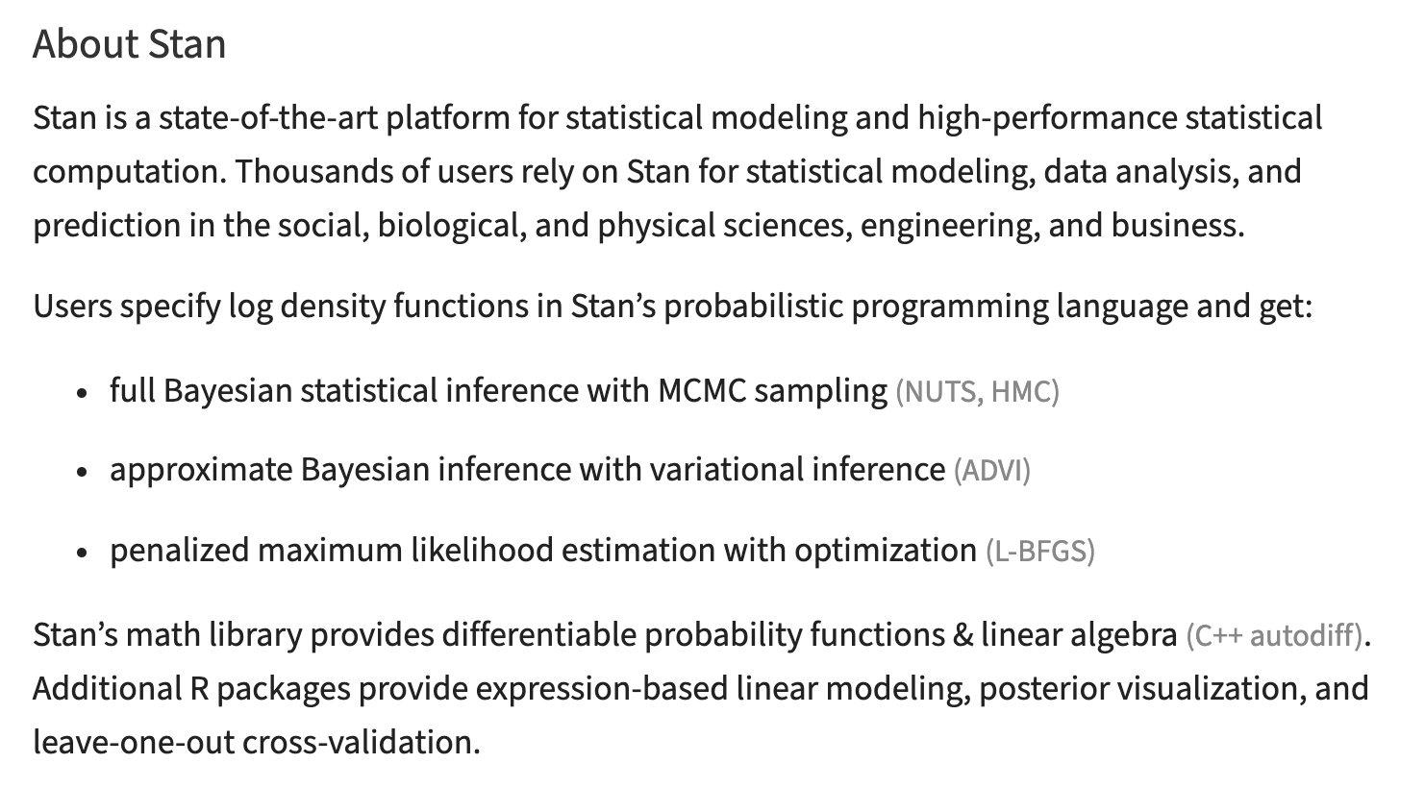

https://mc-stan.org/
Interfaces are available for R, Python, shell, MATLAB, Julia and Stata

Slide 11
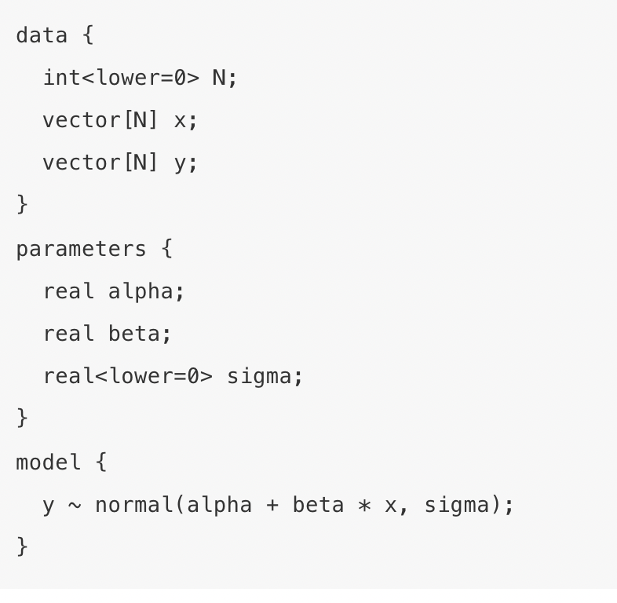
Anatomy of a Stan model
Models in Stan are written in plain text files which are divided into up to 6 program blocks. All are optional, but three of these
(data, parameters, model) are used in most Stan models.
Program blocks in Stan
functions
data
transformed data
parameters
transformed parameters
model
generated quantities
Program blocks must occur in the order above.

Slide 12
Anatomy of a Stan model
Data block declares the objects where the data are stored. The actual data are stored externally (in a list if running Stan from R).
Every variable used in a Stan program must have a declared data type. Only values of that type will be assignable to the variable. This follows the convention of programming languages like C++, not the conventions of scripting languages like Python or statistical languages such as R or BUGS. Primitive types: real and int
Matrix-based types: vector, row_vector matrix Constraints: eg.
vector<lower=-1,upper=1>[3] rho;

Slide 13
Anatomy of a Stan model
Data block declares the objects where the data are stored. The actual data are stored externally (in a list if running Stan from R).
The parameters block declares the variables we are sampling (i.e. the things we want to make inferences about).
Any quantities derived from the variables we define in this block must be declared in the transformed parameters or generated quantities blocks.

Slide 14
Anatomy of a Stan model
Data block declares the objects where the data are stored. The actual data are stored externally (in a list if running Stan from R).
The parameters block declares the variables we are sampling (i.e. the things we want to make inferences about).
The model block consists of optional variable declarations followed by statements. The statements in the model block define the model. and can include probability (sampling notation).
The variables in the model block are local variables are not written as part of the output. Constraints are not allowed.

Slide 15
Anatomy of a Stan model
Many sampling statements are vectorised
parameters {
real mu[N];
real<lower=0> sigma[N];
}
model {
// Unvectorised version
// for (n in 1:N)
// y[n] ~ normal(mu[n], sigma[n]);
// Vectorized version
y ~ normal(mu, sigma);
}
Example from https://www.r-bloggers.com/2019/01/an-introduction-to-stan-with-r/

Slide 16
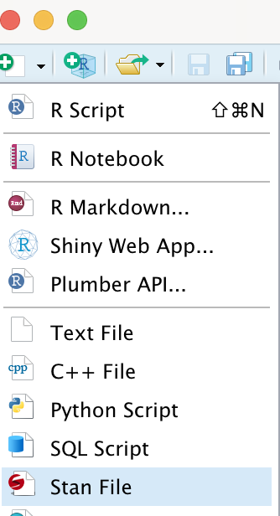
If calling Stan from R typically we create the Stan program in a separate text file. This can be created in Rstudio by choosing “Stan file” from the “New File Menu”

Slide 17
There should be a blank line at the end of the text file defining a Stan model

Slide 18
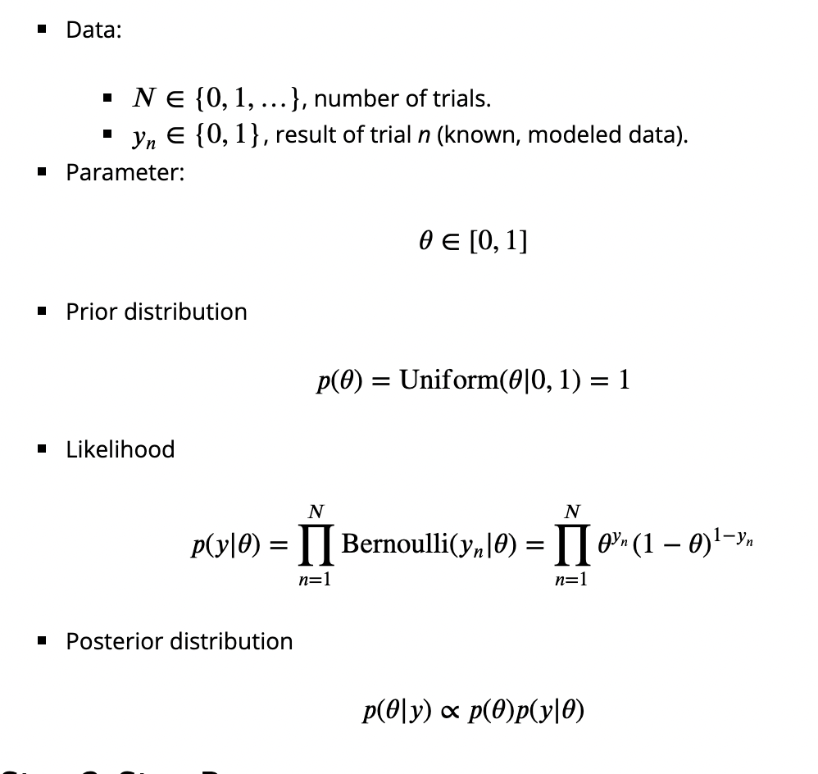
Example: running a Stan model from R
Toy problem: suppose you observe 20 coin flips from a potentially unfair coin. Suppose you have a uniform prior for the probability of heads. Obtain the posterior for this probability after seeing the coin flip data using Stan.
https://www.r-bloggers.com/2019/01/an-introduction-to-stan-with-r/

Slide 19
Example: running a Stan model from R
Toy problem: suppose you observe 20 coin flips from a potentially unfair coin. Suppose you have a uniform prior for the probability of heads. Obtain the posterior for this probability after seeing the coin flip data using Stan.
Stan model (typically we save this in a text file).
data {
int<lower=0> N; // number of coin flips
int<lower=0, upper=1> y[N] // 1=heads, 0=tails
}
parameters {
real<lower=0, upper=1> theta; //prob. heads
}
model {
theta ~ uniform(0, 1); // prior
y ~ bernoulli(theta); //likelihood
}
Adapted from https://www.r-bloggers.com/2019/01/an-introduction-to-stan-with-r/

Slide 20
Example: running a Stan model from R
Toy problem: suppose you observe 20 coin flips from a potentially unfair coin. Suppose you have a uniform prior for the probability of heads. Obtain the posterior for this probability after seeing the coin flip data using Stan.
R code: runcointossmodel.R
Stan model: toymodel.stan
N<-20
y<-c(0,0,1,0,1,1,1,0,1,0,0,0,1,1,0,1,1,0,0,1)
coinflipdata<-list(N=N, y=y)
library(rstan)
# This translates model to C++ and compiles it
fit1 <- stan(
file = "toymodel.stan", # Stan program
data = coinflipdata, # named list of data
chains = 4, # number of Markov chains
warmup = 1000, # number of warmup iterations per chain
iter = 2000, # number of iterations per chain
cores = 2, # number of cores (could use one per chain)
refresh = 0 # no progress shown
)
print(fit1, pars=c("theta"),
probs=c(0.1, 0.5, 0.9), digits = 3)
plot(fit1) traceplot(fit1)
data {
int<lower=0> N; // number of coin flips
int<lower=0, upper=1> y[N]; // 1=heads, 0=tails
}
parameters {
real<lower=0, upper=1> theta; //prob. heads
}
model {
theta ~ uniform(0, 1); // prior
y ~ bernoulli(theta); //likelihood
}

Slide 21
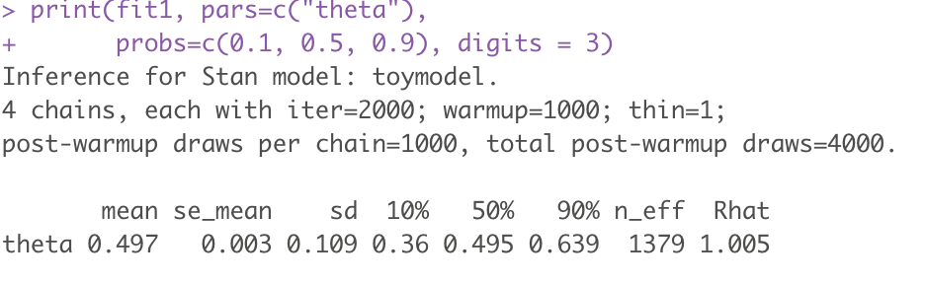
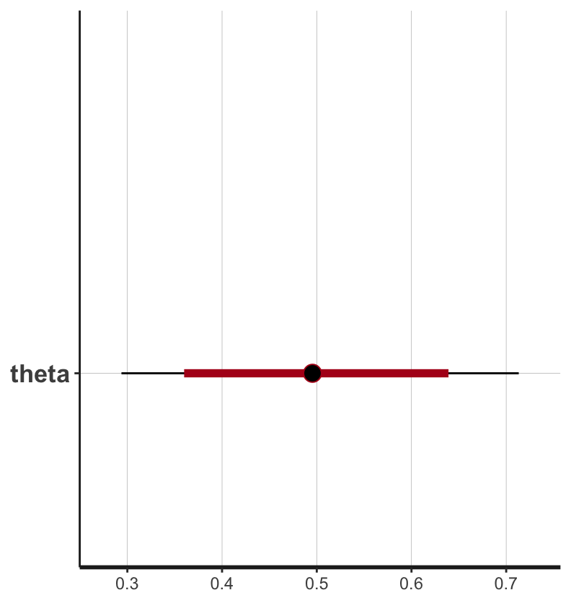
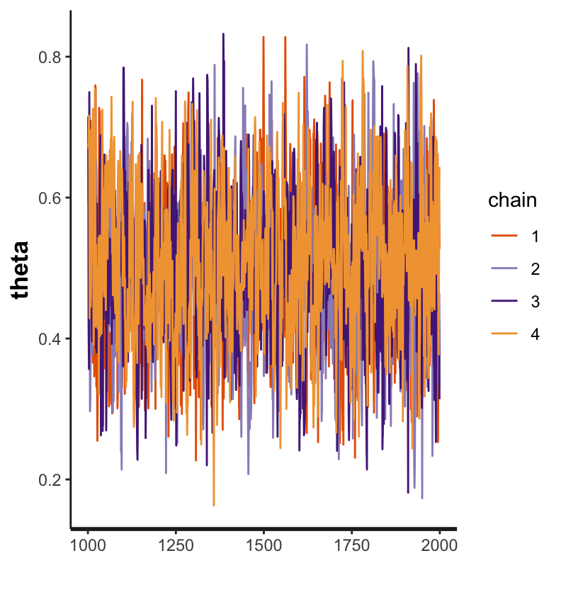
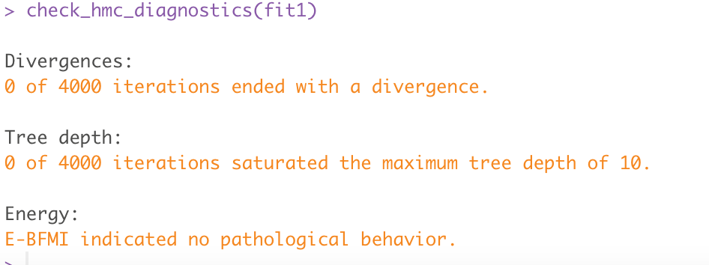
Example: running a Stan model from R
Toy problem: suppose you observe 20 coin flips from a potentially unfair coin. Suppose you have a uniform prior for the probability of heads. Obtain the posterior for this probability after seeing the coin flip data using Stan.
R code: runcointossmodel.R
Output
N<-20
y<-c(0,0,1,0,1,1,1,0,1,0,0,0,1,1,0,1,1,0,0,1)
coinflipdata<-list(N=N, y=y)
library(rstan)
# This translates model to C++ and compiles it
fit1 <- stan(
file = "toymodel.stan", # Stan program
data = coinflipdata, # named list of data
chains = 4, # number of Markov chains
warmup = 1000, # number of warmup iterations per chain
iter = 2000, # number of iterations per chain
cores = 2, # number of cores (could use one per chain)
refresh = 0 # no progress shown
)
print(fit1, pars=c("theta"),
probs=c(0.1, 0.5, 0.9), digits = 3) # 10%, 50%, 90% quantiles
plot(fit1) traceplot(fit1) check_hmc_diagnostics(fit1) # check nothing bad happened

Slide 22
Exercise
Simulate 10,100, 1000, and 1000 coin flips from a coin with a probability of heads of 0.55
Initially using a uniform prior for the probability of heads (so that every value between 0 and 1 has equal prior probability), use Stan to derive posterior distributions for the probability of heads with the three simulated data sets.
Now repeat this but change the code to use a beta prior for theta with parameters α=10, β=10.
Use the print command on the fitted stan object to show the 95% credible interval for the posterior distribution of theta (i.e. 2.5% and 97.5% quantiles).
(the R stan help for the beta distribution can be found here: https://mc-stan.org/docs/2_28/functions-reference/beta-distribution.html)

Slide 23
Divergent transitions “A divergence arises when the simulated Hamiltonian trajectory departs from the true trajectory as measured by departure of the Hamiltonian value from its initial value. When this divergence is too high, the simulation has gone off the rails and cannot be trusted…. The Stan interfaces report divergences as warnings and provide ways to access which iterations encountered divergences. ShinyStan (an R package) provides visualizations that highlight the starting point of divergent transitions to diagnose where the divergences arise in parameter space
https://mc-stan.org/docs/2_19/reference-manual/divergent-transitions

Slide 24
Divergent transitions “A divergence arises when the simulated Hamiltonian trajectory departs from the true trajectory as measured by departure of the Hamiltonian value from its initial value. When this divergence is too high, the simulation has gone off the rails and cannot be trusted…. The Stan interfaces report divergences as warnings and provide ways to access which iterations encountered divergences. ShinyStan (an R package) provides visualizations that highlight the starting point of divergent transitions to diagnose where the divergences arise in parameter space
https://mc-stan.org/docs/2_19/reference-manual/divergent-transitions

Slide 25
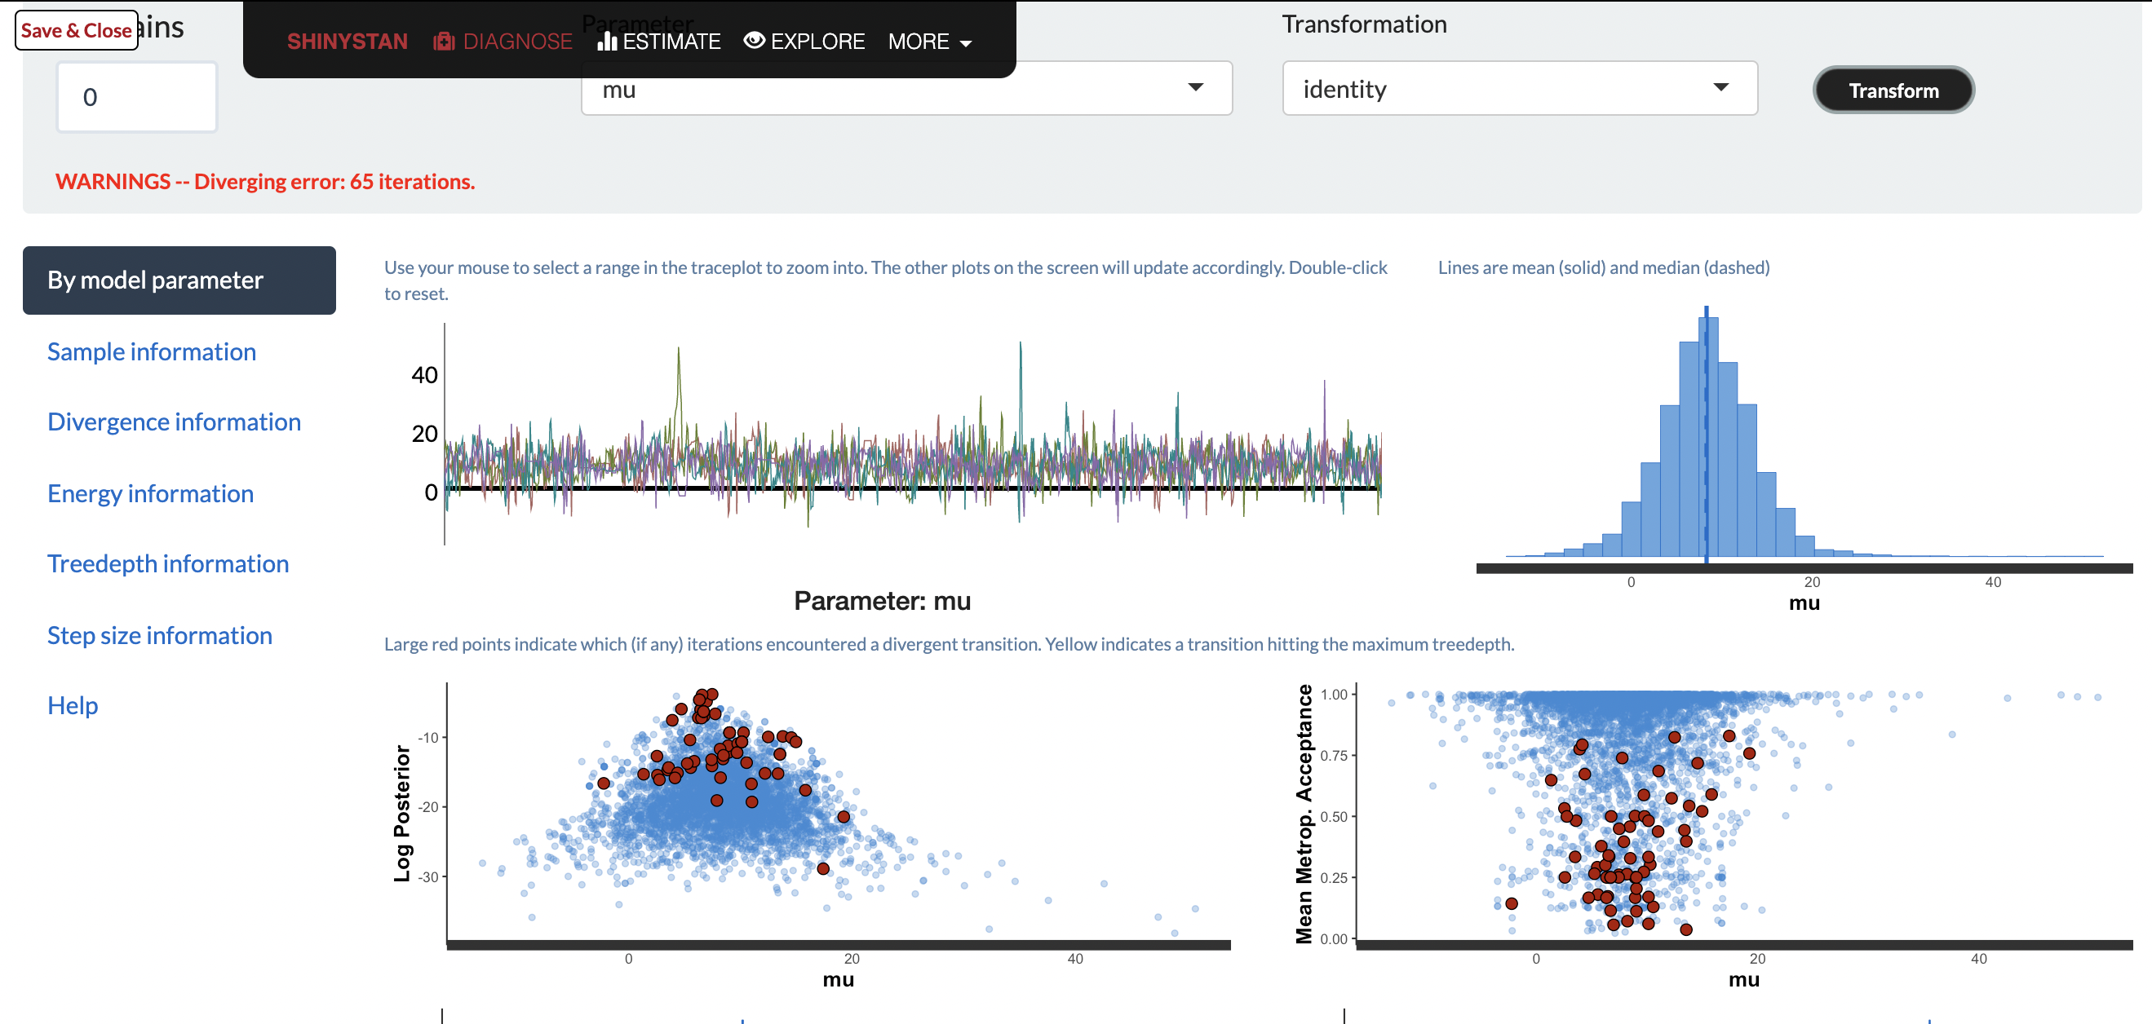
To use ShinyStan interface to look at output from a fitted stan model : i) install R package shinystan; ii) load package with library(shinystan); iii) enter launch_shinystan(fittedstanmodel)

Slide 26
If there are (post-warmup) divergences then the results may be biased and should not be used.
In some cases, simply lowering the initial step size and increasing the target acceptance rate will keep the step size small enough that sampling can proceed.
The exact cause of each divergent transition is printed as a warning message in the output console. This can be useful in cases where managing the step size is insufficient. In such cases, a reparameterization is often required so that the posterior curvature is more manageable; see the section about Neal's Funnel in the Stan manual for an example.
https://mc-stan.org/users/documentation/case-studies/divergences_and_bias.html

Slide 27
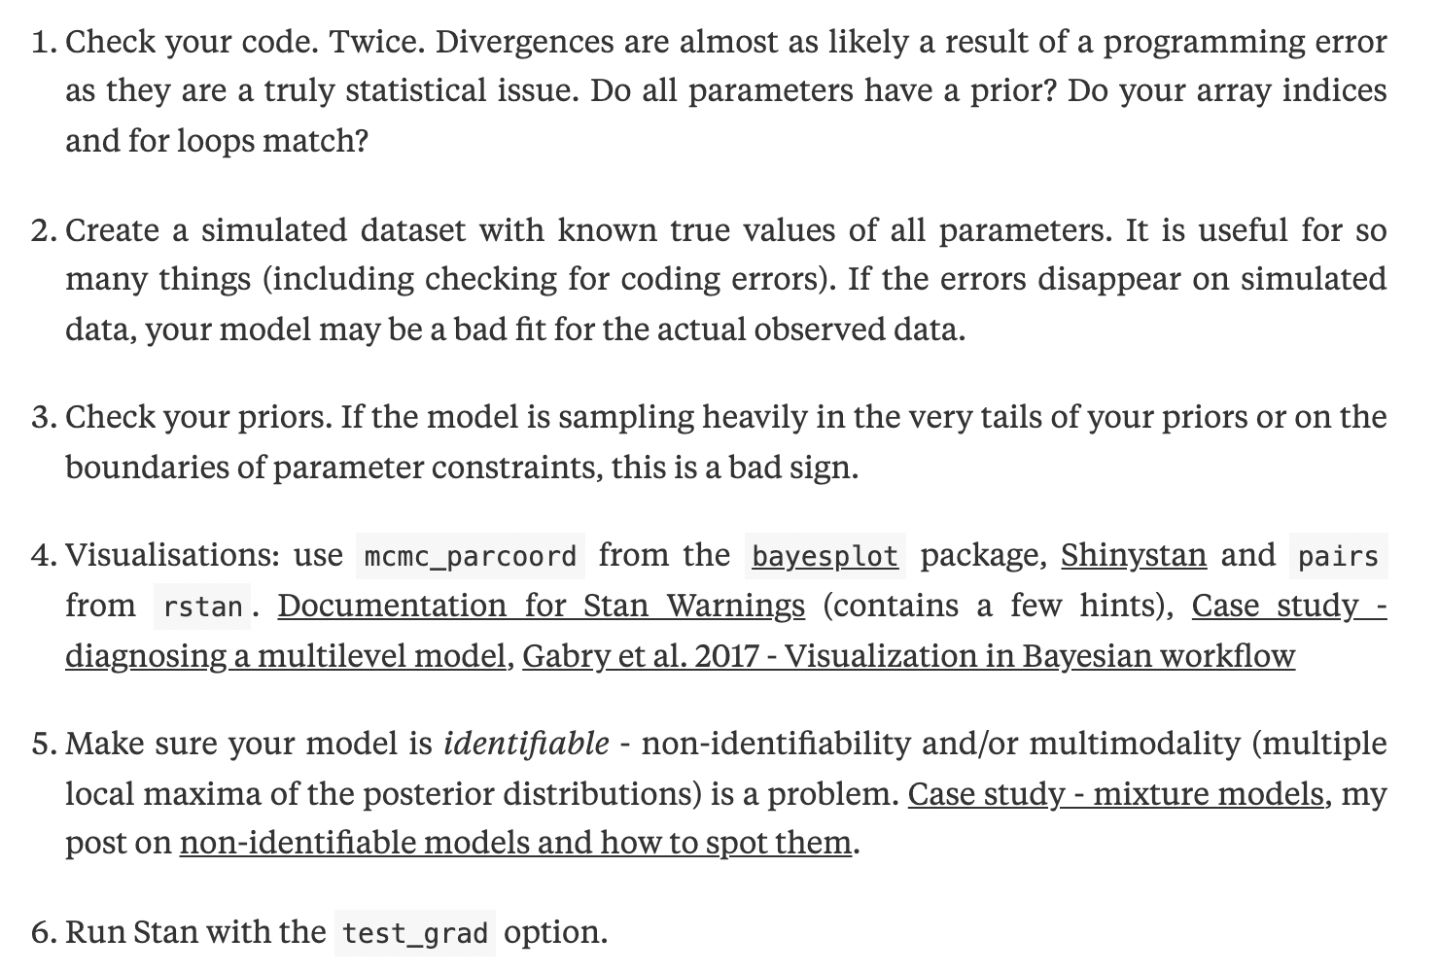
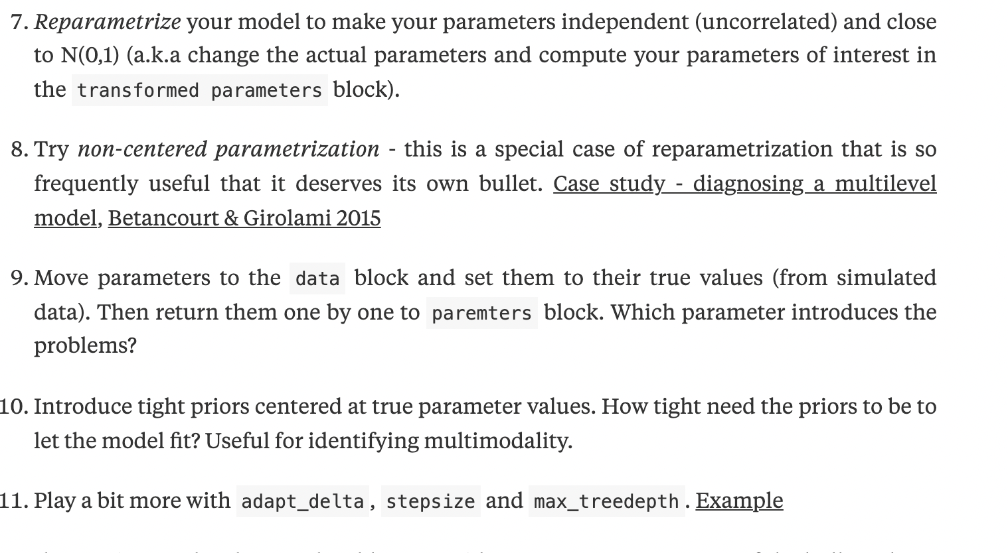
What to do about divergences
https://www.martinmodrak.cz/2018/02/19/taming-divergences-in-stan-models/

